Slide 1
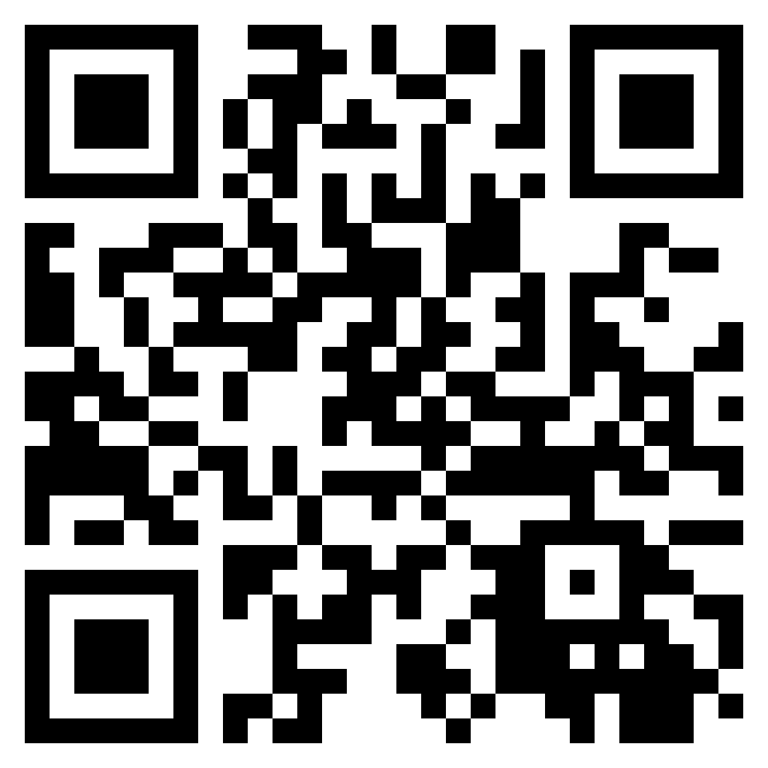
Data Science Skills
Participated in the developing data visualization method (RadViz-plotly) published as a conference paper and as an open-source python package.
Around 1 year experience working in 2U as a TA for data Analytics Boot Camp.
RadViz-plotly
3D-RadViz: Three Dimensional Radial Visualization for Large-Scale Data Visualization

Slide 2

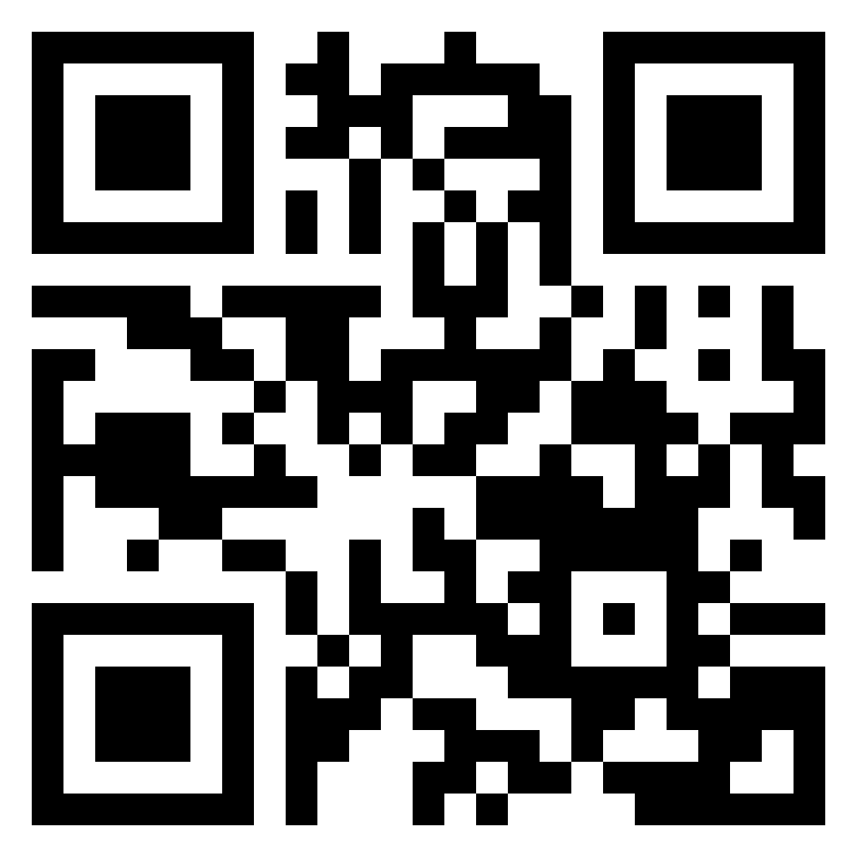
Entrepreneurship skills augmented by R&D skills
3+ years of leadership at Tamra IoT. Tamra IoT won a seed fund in InnoEgypt program at the ICT track.
Participated in the developing a unified interface for the IoT devices, published as a conference paper and as an open-source C++ package.

Slide 3
Autonomous Vehicle experince
+5 months research associated
Participated in the developing Software Defined Vehicle (SDV) course, under review.
Participated in building SDV stack for Collecting real-time vehicle data based on avaialable open-sources platforms

Slide 4
Research skills
7+ years as a Research/Teaching Assistant
Working on introducing SensorsConnect: a search engine for real-time sensing data.

